Slide 1
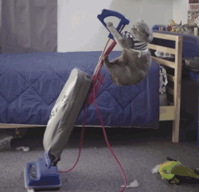
Janitor

Slide 2

Janitor was built with beginning-to-intermediate R users in mind and is optimized for user-friendliness. Advanced users can already do everything covered here, but they can do it faster with janitor and save their thinking for more fun tasks. (Sam Firke)
You should be able to do everything inside janitor on your own, but we don’t have the time to always clean up data without help.

Slide 3

Two Important Functions
clean_names(data)
get_dupes(data, …)

Slide 4
clean_names()

Slide 5
clean_names – why?

Slide 6
Cleaning an Excel Sheet
students <- read_excel(filepath, sheet="Sheet1", col_types = "text") %>%
janitor::clean_names() %>%
janitor::remove_empty(c(“cols”, “rows”)) %>% mutate_at(vars(entry_date, exit_date, student_id, years_in_uncommon), as.numeric) %>%
mutate_at(vars(entry_date, exit_date), janitor::excel_numeric_to_date)

Slide 7
get_dupes()

Slide 8
get_dupes - example
data %>% get_dupes(…)
Names of columns to check for duplicates
Data frame with duplicates

Slide 9
get_dupes – example with student roster
students %>% get_dupes(student_id)
Names of columns to check for duplicates
Data frame with duplicates
# A tibble: 2 x 6
student_id dupe_count grade yearsinuncommon entry_date exit_date
<dbl> <int> <dbl> <dbl> <date> <date>
1 7851976 2 5 1 2017-11-12 2017-12-12
2 7851976 2 6 1 2017-11-12 2017-12-12

Slide 10
Practice – what does get_dupes do?
select
arrange
filter
mutate
group_by
summarize

Slide 11
Answer
students %>%
group_by(student_id) %>%
mutate(dupe_count = n() ) %>%
filter(dupe_count > 1) %>%
select(student_id, dupe_count, everything() )
group_by columns to check for duplicates
mutate
Count the # of rows in each “group”
filter
Keep only rows that have duplicates
select
Reorder the columns

Slide 12
Correcting Duplicates
Version 1. Correct the dupes individually with if_else or case_when
students %>%
mutate(grade = if_else(student_id == 7851976, 5, grade)) %>%
distinct()
Version 2. Simplify the data by summarizing the min or max of the duplicate causing column
students %>%
group_by(student_id) %>%
summarize(grade = min(grade))
Version 3. Output the duplicates and manually choose which version to keep
dupes_remove <- read_csv("dupes_correct.csv") %>%
filter(del == 1)
anti_join(students, dupes_remove)

Slide 13
Your Turn– Duplicates
Find duplicates in the practice sat exam set.
Take a look at the data set. What do you see? What do you think this data is? What is this data unique by?
What is the student identifier in this data?
What other columns do you need to include in your dupes check?
What business rules should you ask about when correcting duplicates?
Notes:
myconn <- RODBC::odbcConnect("ia_dw", uid="userid", pwd="password") # make sure to set your ODBC connection, connects to USI-SQL3-2k8
results_raw <- RODBC::sqlQuery(myconn,"SELECT * FROM pr_sat_results_standards", as.is=T)
close(myconn)
results_raw %>%
select(student_number, cycle, academic_year, name, school,
grade, sat_exam,
test_version, subject, subject_percent_correct
) %>%
distinct() %>%
mutate_at(vars(subject_percent_correct), as.numeric) %>%
rename(percent_correct = subject_percent_correct) %>%
write_csv("../data/practice_sat_cycle1.csv", na = "")

Slide 14
Tidy Data with tidyr()

Slide 15
"Data are not just numbers, they are numbers with a context."
- George Cobb and David Moore (1997)
"Data are not just numbers,
they are numbers with a context."
- George Cobb and David Moore (1997)

Slide 16
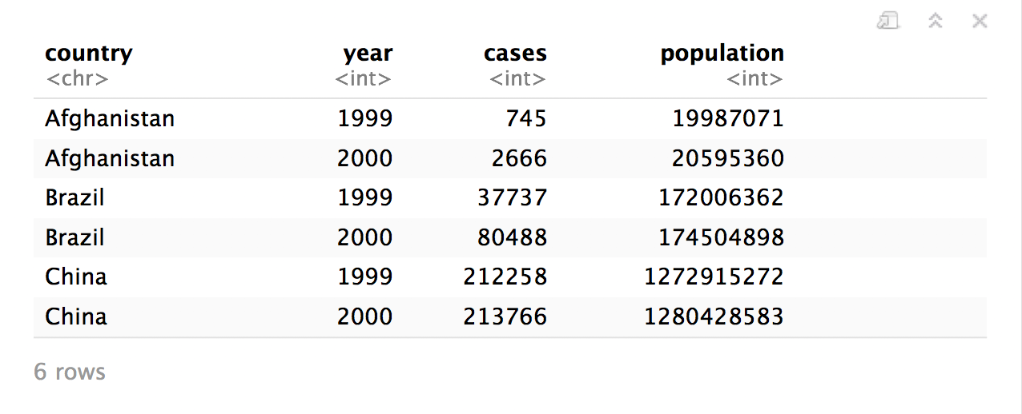
Quiz
What are the variables in this data set?
table1

Slide 17
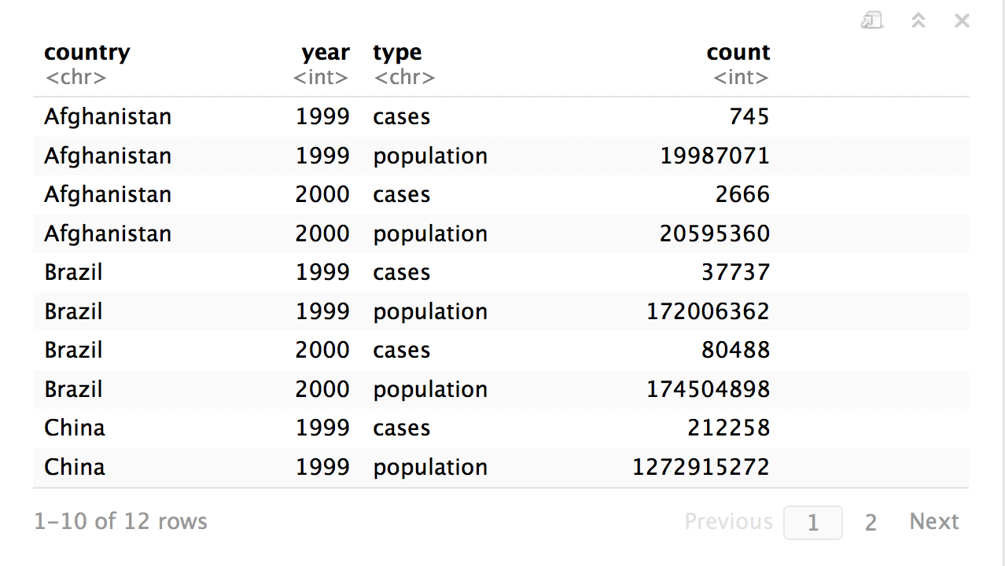
Quiz
What are the variables in this data set?
table2

Slide 18
Tidy Data
country | year | cases | pop
Afghanistan | 1999 | 745 | 19987071
Afghanistan | 2000 | 2666 | 20595360
Brazil | 1999 | 37737 | 172006362
Brazil | 2000 | 80488 | 174504898
China | 1999 | 212258 | 1272915272
China | 2000 | 213766 | 1280428583
A data set is tidy iff:
Each variable is in its own column
Each case is in its own row
Each value is in its own cell

Slide 19
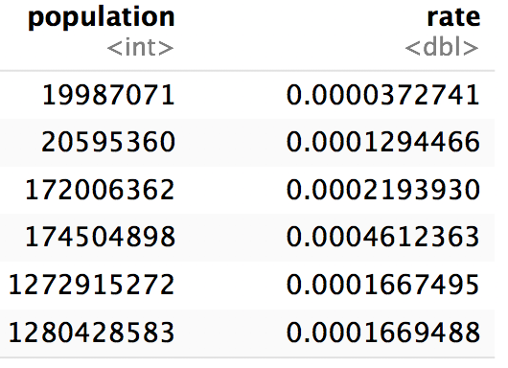
Tidy Data is easy to manipulate

Slide 20
"Tidy data sets are all alike; but every messy data set is messy in its own way."
- Hadley Wickham

Slide 21
tidyr
R package
# install.packages("tidyr")
library(tidyr)

Slide 22
pivot_longer()

Slide 23
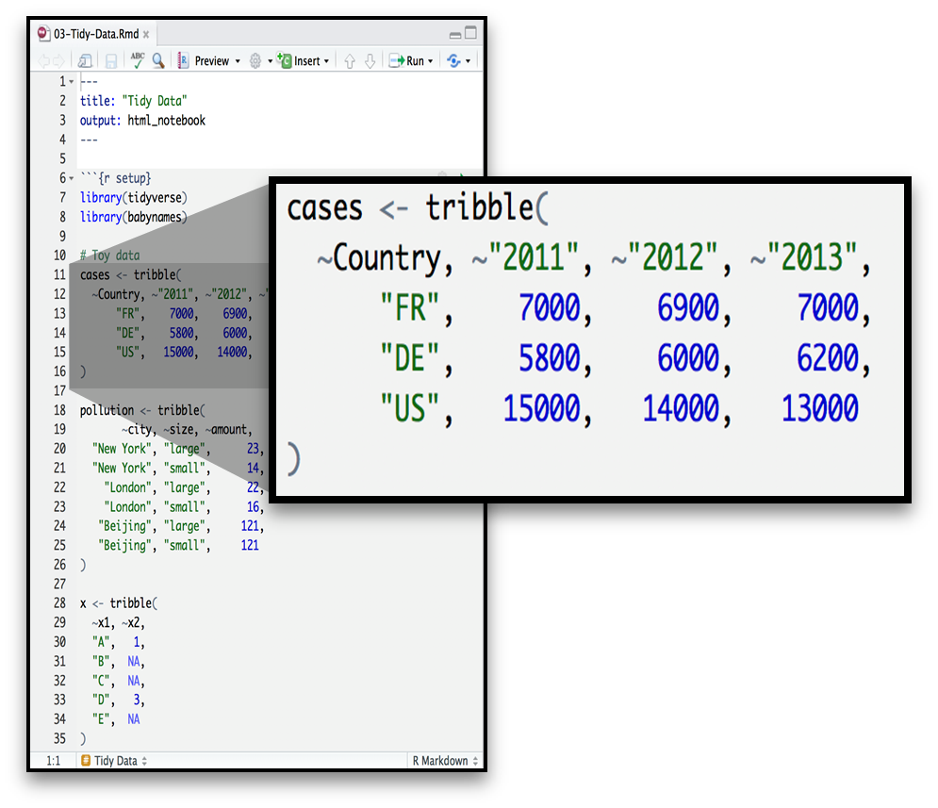
Toy Data - Wide

Slide 24
Your Turn
On a sheet of paper, draw how the cases data set would look if it had the same values_from grouped into three columns: country, year, n
Country | 2011 | 2012 | 2013
FR | 7000 | 6900 | 7000
DE | 5800 | 6000 | 6200
US | 15000 | 14000 | 13000

Slide 25
Country | 2011 | 2012 | 2013
FR | 7000 | 6900 | 7000
DE | 5800 | 6000 | 6200
US | 15000 | 14000 | 13000

Slide 26
Country | 2011 | 2012 | 2013
FR | 7000 | 6900 | 7000
DE | 5800 | 6000 | 6200
US | 15000 | 14000 | 13000
Country | Year | n
FR | 2011 | 7000
DE | 2011 | 5800
US | 2011 | 15000
FR | 2012 | 6900
DE | 2012 | 6000
US | 2012 | 14000
FR | 2013 | 7000
DE | 2013 | 6200
US | 2013 | 13000

Slide 27
Country | 2011 | 2012 | 2013
FR | 7000 | 6900 | 7000
DE | 5800 | 6000 | 6200
US | 15000 | 14000 | 13000
Country | Year | n
FR | 2011 | 7000
DE | 2011 | 5800
US | 2011 | 15000
FR | 2012 | 6900
DE | 2012 | 6000
US | 2012 | 14000
FR | 2013 | 7000
DE | 2013 | 6200
US | 2013 | 13000

Slide 28
Country | 2011 | 2012 | 2013
FR | 7000 | 6900 | 7000
DE | 5800 | 6000 | 6200
US | 15000 | 14000 | 13000
Country | Year | n
FR | 2011 | 7000
DE | 2011 | 5800
US | 2011 | 15000
FR | 2012 | 6900
DE | 2012 | 6000
US | 2012 | 14000
FR | 2013 | 7000
DE | 2013 | 6200
US | 2013 | 13000

Slide 29
Country | 2011 | 2012 | 2013
FR | 7000 | 6900 | 7000
DE | 5800 | 6000 | 6200
US | 15000 | 14000 | 13000
Country | Year | n
FR | 2011 | 7000
DE | 2011 | 5800
US | 2011 | 15000
FR | 2012 | 6900
DE | 2012 | 6000
US | 2012 | 14000
FR | 2013 | 7000
DE | 2013 | 6200
US | 2013 | 13000

Slide 30
Country | 2011 | 2012 | 2013
FR | 7000 | 6900 | 7000
DE | 5800 | 6000 | 6200
US | 15000 | 14000 | 13000
Country | Year | n
FR | 2011 | 7000
DE | 2011 | 5800
US | 2011 | 15000
FR | 2012 | 6900
DE | 2012 | 6000
US | 2012 | 14000
FR | 2013 | 7000
DE | 2013 | 6200
US | 2013 | 13000

Slide 31
Country | 2011 | 2012 | 2013
FR | 7000 | 6900 | 7000
DE | 5800 | 6000 | 6200
US | 15000 | 14000 | 13000
Country | Year | n
FR | 2011 | 7000
DE | 2011 | 5800
US | 2011 | 15000
FR | 2012 | 6900
DE | 2012 | 6000
US | 2012 | 14000
FR | 2013 | 7000
DE | 2013 | 6200
US | 2013 | 13000

Slide 32
Country | 2011 | 2012 | 2013
FR | 7000 | 6900 | 7000
DE | 5800 | 6000 | 6200
US | 15000 | 14000 | 13000
Country | Year | n
FR | 2011 | 7000
DE | 2011 | 5800
US | 2011 | 15000
FR | 2012 | 6900
DE | 2012 | 6000
US | 2012 | 14000
FR | 2013 | 7000
DE | 2013 | 6200
US | 2013 | 13000

Slide 33
Final Answers – pivot_longer() practice
Country | 2011 | 2012 | 2013
FR | 7000 | 6900 | 7000
DE | 5800 | 6000 | 6200
US | 15000 | 14000 | 13000
Country | Year | n
FR | 2011 | 7000
DE | 2011 | 5800
US | 2011 | 15000
FR | 2012 | 6900
DE | 2012 | 6000
US | 2012 | 14000
FR | 2013 | 7000
DE | 2013 | 6200
US | 2013 | 13000

Slide 34
Country | 2011 | 2012 | 2013
FR | 7000 | 6900 | 7000
DE | 5800 | 6000 | 6200
US | 15000 | 14000 | 13000
Country | Year | n
FR | 2011 | 7000
DE | 2011 | 5800
US | 2011 | 15000
FR | 2012 | 6900
DE | 2012 | 6000
US | 2012 | 14000
FR | 2013 | 7000
DE | 2013 | 6200
US | 2013 | 13000
Country | Year | n
FR | 2011 | 7000
DE | 2011 | 5800
US | 2011 | 15000
FR | 2012 | 6900
DE | 2012 | 6000
US | 2012 | 14000
FR | 2013 | 7000
DE | 2013 | 6200
US | 2013 | 13000

Slide 35
Country | Year | n
FR | 2011 | 7000
DE | 2011 | 5800
US | 2011 | 15000
FR | 2012 | 6900
DE | 2012 | 6000
US | 2012 | 14000
FR | 2013 | 7000
DE | 2013 | 6200
US | 2013 | 13000
Country | 2011 | 2012 | 2013
FR | 7000 | 6900 | 7000
DE | 5800 | 6000 | 6200
US | 15000 | 14000 | 13000
Country | Year | n
FR | 2011 | 7000
DE | 2011 | 5800
US | 2011 | 15000
FR | 2012 | 6900
DE | 2012 | 6000
US | 2012 | 14000
FR | 2013 | 7000
DE | 2013 | 6200
US | 2013 | 13000
pivot_longer

Slide 36
1
2
Country | 2011 | 2012 | 2013
FR | 7000 | 6900 | 7000
DE | 5800 | 6000 | 6200
US | 15000 | 14000 | 13000
Country | Year | n
FR | 2011 | 7000
DE | 2011 | 5800
US | 2011 | 15000
FR | 2012 | 6900
DE | 2012 | 6000
US | 2012 | 14000
FR | 2013 | 7000
DE | 2013 | 6200
US | 2013 | 13000
Country | Year | n
FR | 2011 | 7000
DE | 2011 | 5800
US | 2011 | 15000
FR | 2012 | 6900
DE | 2012 | 6000
US | 2012 | 14000
FR | 2013 | 7000
DE | 2013 | 6200
US | 2013 | 13000

Slide 37
former column names
Country | 2011 | 2012 | 2013
FR | 7000 | 6900 | 7000
DE | 5800 | 6000 | 6200
US | 15000 | 14000 | 13000
Country | Year | n
FR | 2011 | 7000
DE | 2011 | 5800
US | 2011 | 15000
FR | 2012 | 6900
DE | 2012 | 6000
US | 2012 | 14000
FR | 2013 | 7000
DE | 2013 | 6200
US | 2013 | 13000
Country | Year | n
FR | 2011 | 7000
DE | 2011 | 5800
US | 2011 | 15000
FR | 2012 | 6900
DE | 2012 | 6000
US | 2012 | 14000
FR | 2013 | 7000
DE | 2013 | 6200
US | 2013 | 13000

Slide 38
name_to values_from_to
Country | 2011 | 2012 | 2013
FR | 7000 | 6900 | 7000
DE | 5800 | 6000 | 6200
US | 15000 | 14000 | 13000
Country | Year | n
FR | 2011 | 7000
DE | 2011 | 5800
US | 2011 | 15000
FR | 2012 | 6900
DE | 2012 | 6000
US | 2012 | 14000
FR | 2013 | 7000
DE | 2013 | 6200
US | 2013 | 13000
Country | Year | n
FR | 2011 | 7000
DE | 2011 | 5800
US | 2011 | 15000
FR | 2012 | 6900
DE | 2012 | 6000
US | 2012 | 14000
FR | 2013 | 7000
DE | 2013 | 6200
US | 2013 | 13000

Slide 39
pivot_longer()
cases %>%
pivot_longer(2:4, names_to = “year”, values_to = “n”)
data frame to reshape
numeric indexes of columns to collapse
(or names)
name of the new names_from column
(a character string)
name of the new value column
(a character string)
Country | 2011 | 2012 | 2013
FR | 7000 | 6900 | 7000
DE | 5800 | 6000 | 6200
US | 15000 | 14000 | 13000

Slide 40
pivot_longer()
cases %>%
pivot_longer(`2011`:`2013`, names_to = “year”, values_to = “n”)
data frame to reshape
Names of columns to collapse
name of the new names_from column
(a character string)
name of the new value column
(a character string)
Country | 2011 | 2012 | 2013
FR | 7000 | 6900 | 7000
DE | 5800 | 6000 | 6200
US | 15000 | 14000 | 13000

Slide 41
pivot_longer()
cases %>%
pivot_longer(-Country, names_to = “year”, values_to = “n”)
data frame to reshape
Names of columns to collapse
name of the new names_from column
(a character string)
name of the new value column
(a character string)
Country | 2011 | 2012 | 2013
FR | 7000 | 6900 | 7000
DE | 5800 | 6000 | 6200
US | 15000 | 14000 | 13000

Slide 42
pivot_longer() - examples
cases %>% pivot_longer(2:4, names_to = “year”, values_to = “n”)
cases %>%
pivot_longer(`2011`:`2013`, names_to = “year”, values_to = “n”)
cases %>%
pivot_longer(-Country, names_to = “year”, values_to = “n”)

Slide 43
select() helpers
: Select range of columns
select(storms, storm:pressure)
- Select every column but
select(storms, -c(storm, pressure))
starts_with() - Select columns that start with…
select(storms, starts_with("w"))
ends_with() - Select columns that end with…
select(storms, ends_with("e"))

Slide 44
select() helpers
contains() - Select columns whose names contain…
select(storms, contains("d"))
matches() - Select columns whose names match regular expression
select(storms, matches("^.{4}$"))
one_of() - Select columns whose names are one of a set
select(storms, one_of(c("storm", "storms", "Storm"))
num_range() - Select columns named in prefix, number style
select(storms, num_range("x", 1:5))

Slide 45
Check for Understanding
(Select All) Which of these will create tidy data?
cases %>% clean_names() %>% select(country, year, n)
cases %>% pivot_longer(Country, names_to = “year”, values_to = “n”)
cases %>% pivot_longer(-Country, names_to=“year”, values_to=“values”)
babynames

Slide 46
Check for Understanding
(Select All) Which of these will create tidy data?
cases %>% clean_names() %>% select(country, year, n)
cases %>% pivot_longer(Country, names_to = “year”, values_to = “n”)
cases %>% pivot_longer(-Country, names_to=“year”, values_to=“values”)
babynames

Slide 47
pivot_wider()

Slide 48
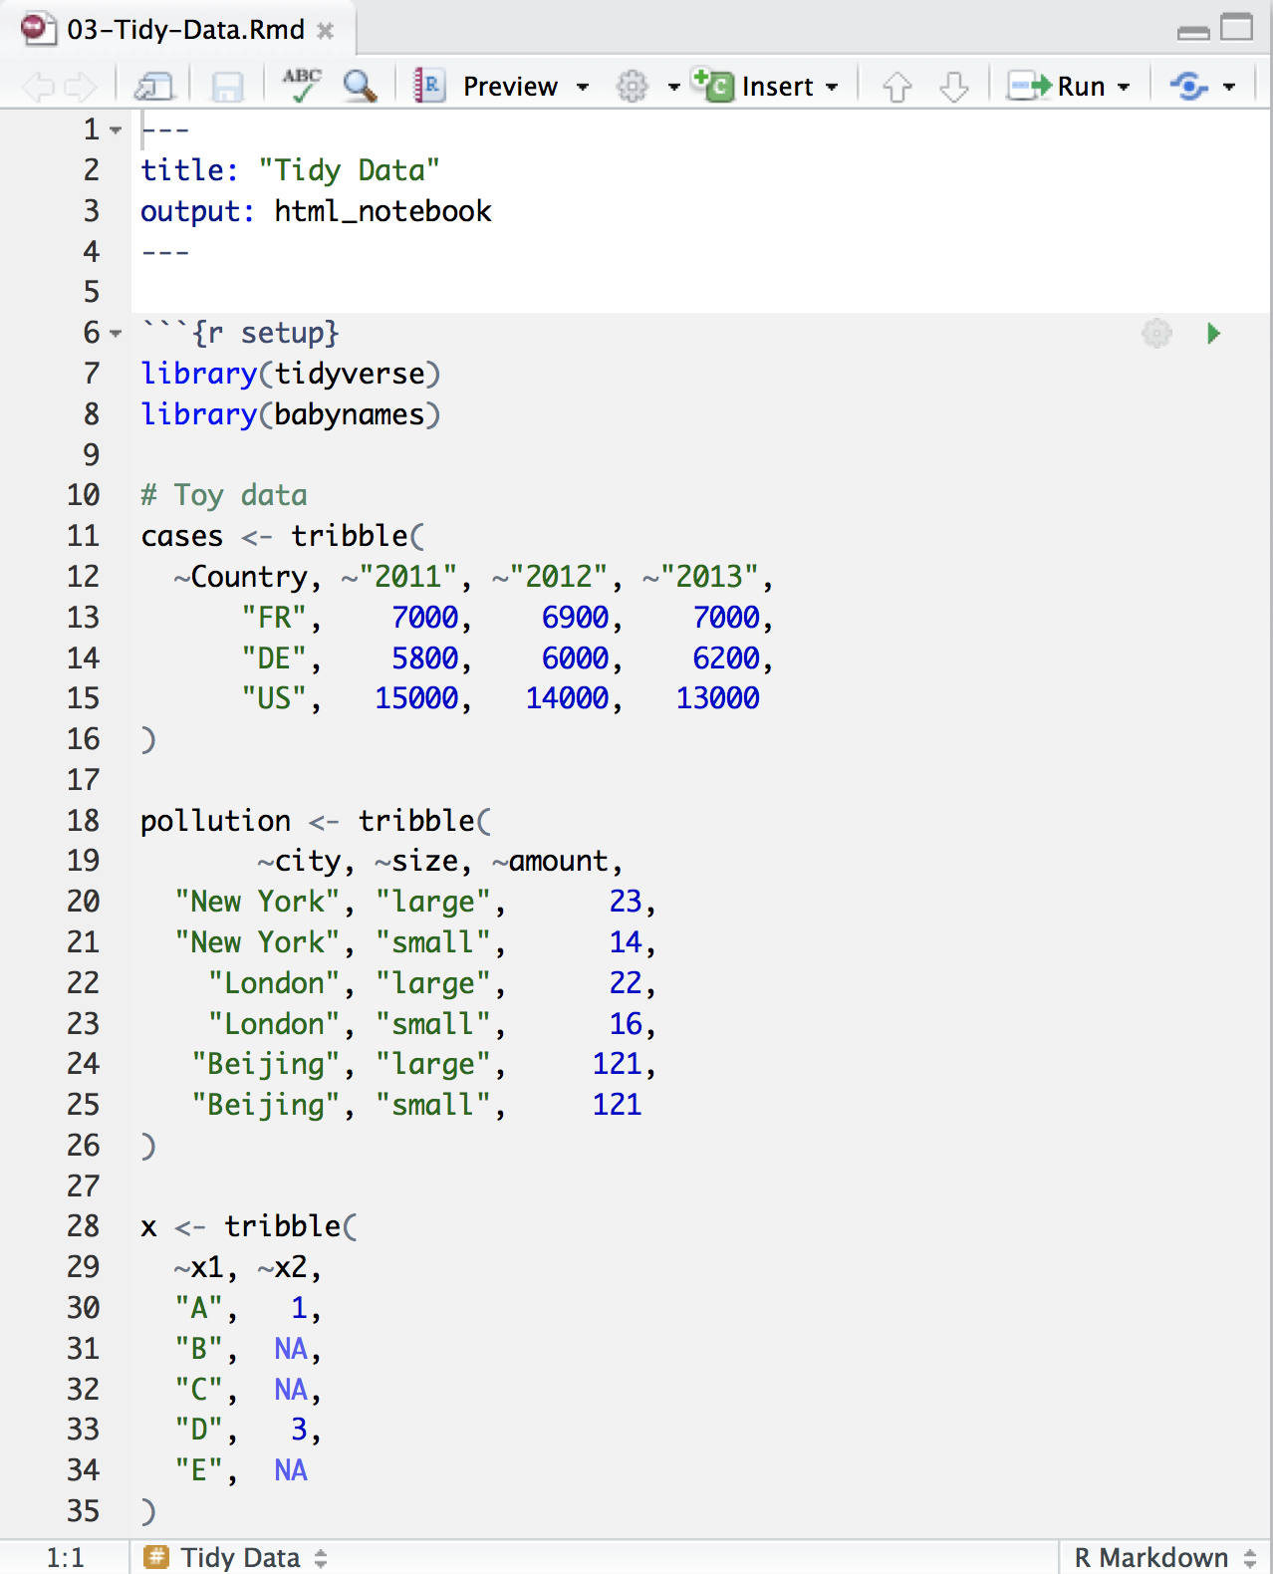
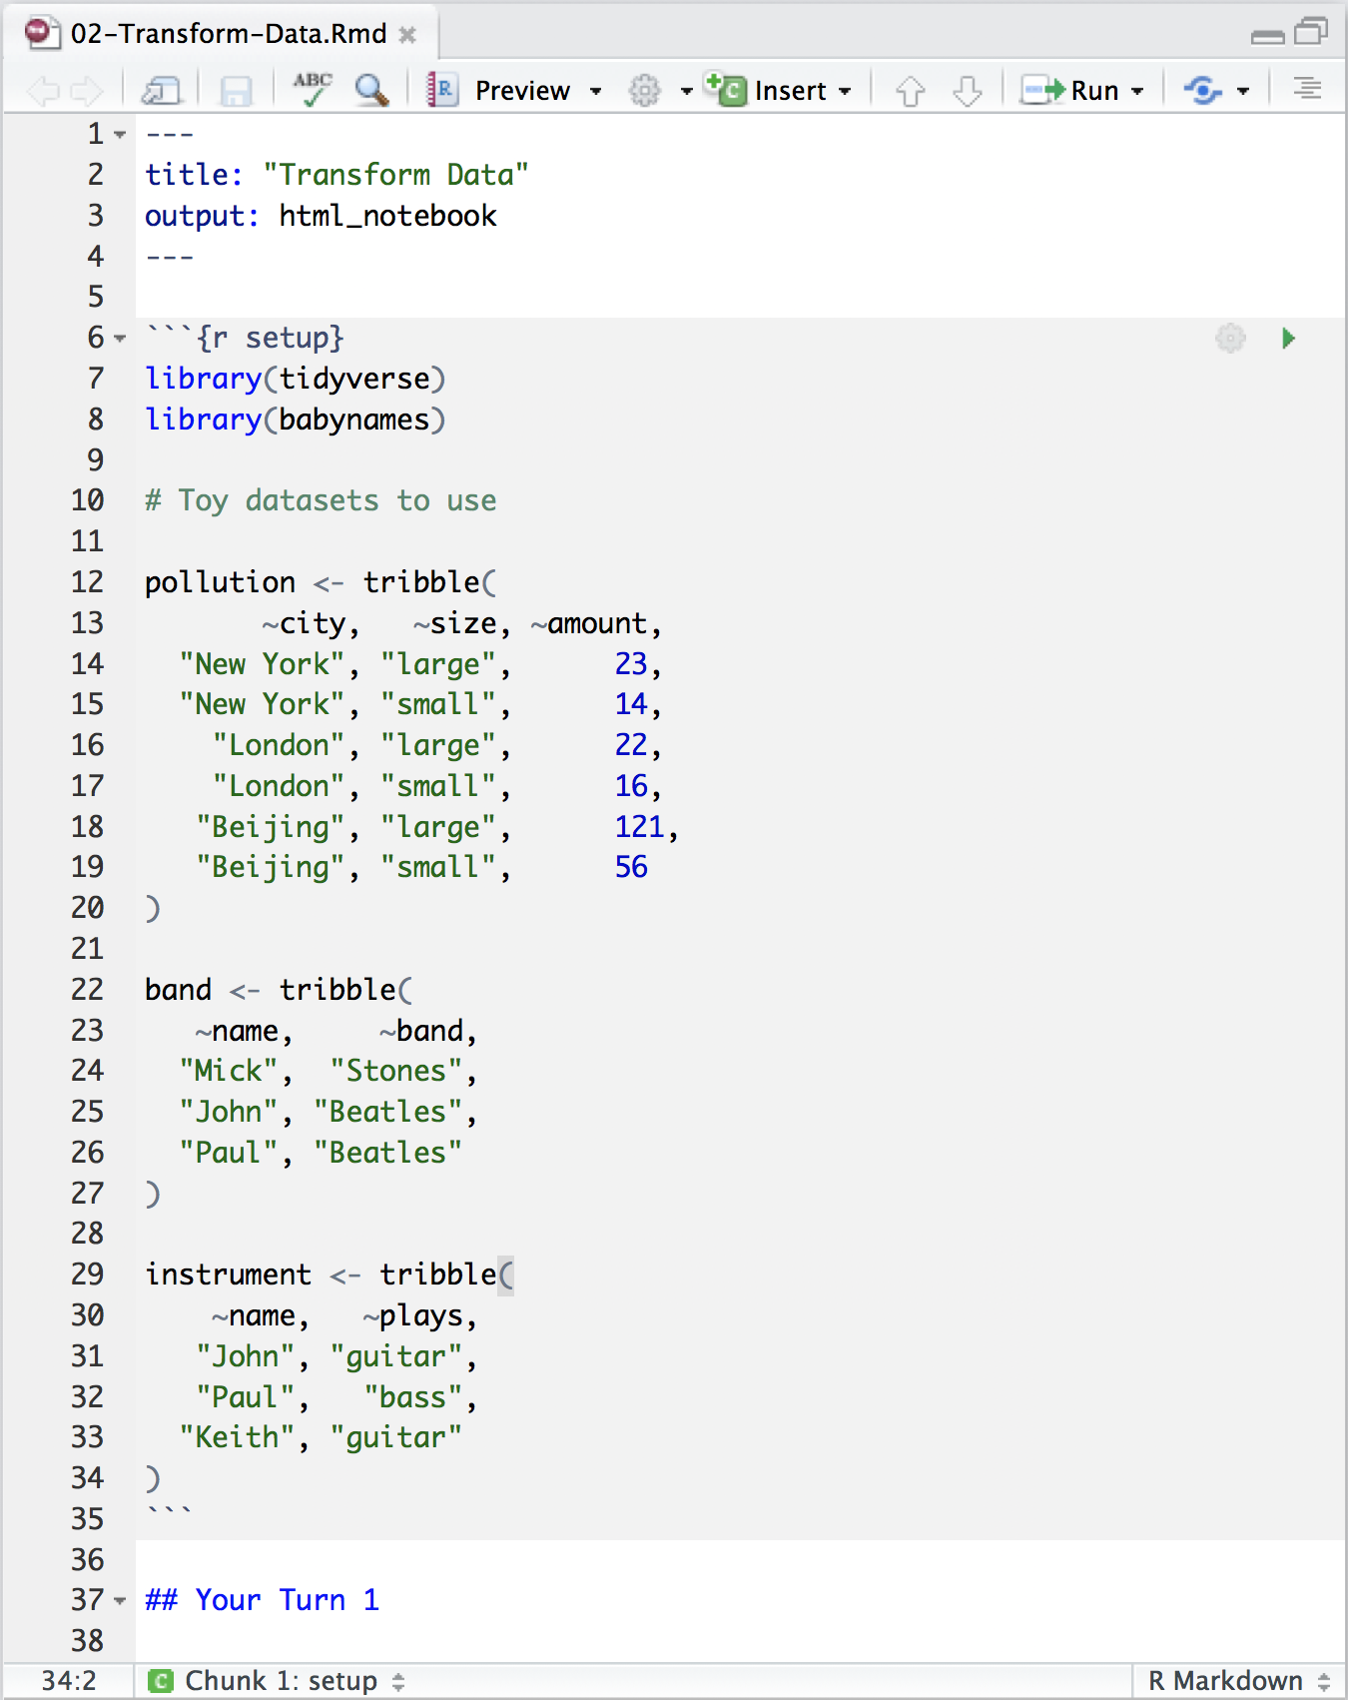
Toy Data

Slide 49
Quiz
What are the variables in the pollution data set?
city | particle size | amount (µg/m³)
New York | large | 23
New York | small | 14
London | large | 22
London | small | 16
Beijing | large | 121
Beijing | small | 56

Slide 50
Quiz
What are the variables in the pollution data set?
city | particle size | amount (µg/m³)
New York | large | 23
New York | small | 14
London | large | 22
London | small | 16
Beijing | large | 121
Beijing | small | 56

Slide 51
Your Turn
On a sheet of paper, draw how the pollution data set would look if it had the same values grouped into three columns: city, large, small
city | particle size | amount (µg/m³)
New York | large | 23
New York | small | 14
London | large | 22
London | small | 16
Beijing | large | 121
Beijing | small | 56

Slide 52
city | size | amount
New York | large | 23
New York | small | 14
London | large | 22
London | small | 16
Beijing | large | 121
Beijing | small | 56

Slide 53
city | size | amount
New York | large | 23
New York | small | 14
London | large | 22
London | small | 16
Beijing | large | 121
Beijing | small | 56
city | large | small
New York | 23 | 14
London | 22 | 16
Beijing | 121 | 56

Slide 54
city | size | amount
New York | large | 23
New York | small | 14
London | large | 22
London | small | 16
Beijing | large | 121
Beijing | small | 56
city | large | small
New York | 23 | 14
London | 22 | 16
Beijing | 121 | 56

Slide 55
city | size | amount
New York | large | 23
New York | small | 14
London | large | 22
London | small | 16
Beijing | large | 121
Beijing | small | 56
city | large | small
New York | 23 | 14
London | 22 | 16
Beijing | 121 | 56

Slide 56
city | size | amount
New York | large | 23
New York | small | 14
London | large | 22
London | small | 16
Beijing | large | 121
Beijing | small | 56
city | large | small
New York | 23 | 14
London | 22 | 16
Beijing | 121 | 56

Slide 57
city | size | amount
New York | large | 23
New York | small | 14
London | large | 22
London | small | 16
Beijing | large | 121
Beijing | small | 56
city | large | small
New York | 23 | 14
London | 22 | 16
Beijing | 121 | 56

Slide 58
city | size | amount
New York | large | 23
New York | small | 14
London | large | 22
London | small | 16
Beijing | large | 121
Beijing | small | 56
city | large | small
New York | 23 | 14
London | 22 | 16
Beijing | 121 | 56

Slide 59
city | size | amount
New York | large | 23
New York | small | 14
London | large | 22
London | small | 16
Beijing | large | 121
Beijing | small | 56
city | large | small
New York | 23 | 14
London | 22 | 16
Beijing | 121 | 56

Slide 60
city | size | amount
New York | large | 23
New York | small | 14
London | large | 22
London | small | 16
Beijing | large | 121
Beijing | small | 56
city | large | small
New York | 23 | 14
London | 22 | 16
Beijing | 121 | 56

Slide 61
city | size | amount
New York | large | 23
New York | small | 14
London | large | 22
London | small | 16
Beijing | large | 121
Beijing | small | 56
pivot_wider()
city | large | small
New York | 23 | 14
London | 22 | 16
Beijing | 121 | 56

Slide 62
1
2
city | size | amount
New York | large | 23
New York | small | 14
London | large | 22
London | small | 16
Beijing | large | 121
Beijing | small | 56
city | large | small
New York | 23 | 14
London | 22 | 16
Beijing | 121 | 56

Slide 63
names_from
city | size | amount
New York | large | 23
New York | small | 14
London | large | 22
London | small | 16
Beijing | large | 121
Beijing | small | 56
city | large | small
New York | 23 | 14
London | 22 | 16
Beijing | 121 | 56

Slide 64
names_from
values_from
city | size | amount
New York | large | 23
New York | small | 14
London | large | 22
London | small | 16
Beijing | large | 121
Beijing | small | 56
city | large | small
New York | 23 | 14
London | 22 | 16
Beijing | 121 | 56

Slide 65
pivot_wider()
pollution %>%
pivot_wider(names_from = size,
values_from = amount)
data frame to reshape
column to use for names_froms (becomes new
column names)
column to use for values_from
(becomes new
column cells)

Slide 66
pollution %>% pivot_wider(size, amount)
city size amount
1 New York large 23
2 New York small 14
3 London large 22
4 London small 16
5 Beijing large 121
6 Beijing small 56
city large small
1 Beijing 121 56
2 London 22 16
3 New York 23 14

Slide 67
pivot_wider Tips and Tricks
Most tidyverse functions are made to work with LONG (tidy) data, so it is often better to wait till near the end of the code to shift to WIDE data if needed for output
Make sure to SELECT all the columns you need before a pivot_wider to remove columns that may cause problems (duplicates)
New change! You CAN pivot_wider more than one column! The pivot_wider help file has information on how to do this,

Slide 68
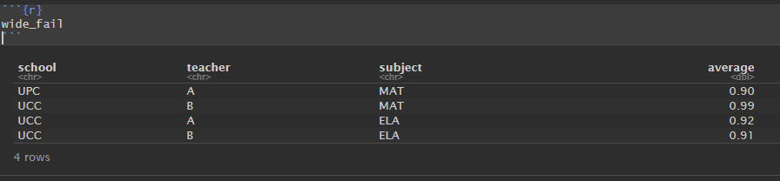
wide_fail
Make sure to SELECT all the columns you need before a pivot_wider to remove columns that may cause problems (duplicates)

Slide 69
wide_fail
Make sure to SELECT all the columns you need before a pivot_wider to remove columns that may cause problems (duplicates)
wide_fail %>%
pivot_wider(names_from = subject,
values_from = average)
school | teacher | ELA | MAT
UCC | A | 0.92 | NA
UCC | B | 0.91 | 0.99
UPC | A | NA | 0.90

Slide 70
wide_fail
Make sure to SELECT all the columns you need before a pivot_wider to remove columns that may cause problems (duplicates)
wide_fail %>%
pivot_wider(names_from = subject,
values_from = average)
school | teacher | ELA | MAT
UCC | A | 0.92 | NA
UCC | B | 0.91 | 0.99
UPC | A | NA | 0.90

Slide 71

Untidy Data
WHO (World Health Organization)

Slide 72
WHO
Tuberculosis (TB) cases broken down by year, country, age, gender, and diagnosis method from the 2014 World Health Organization Global Tuberculosis Report
View(who)

Slide 73
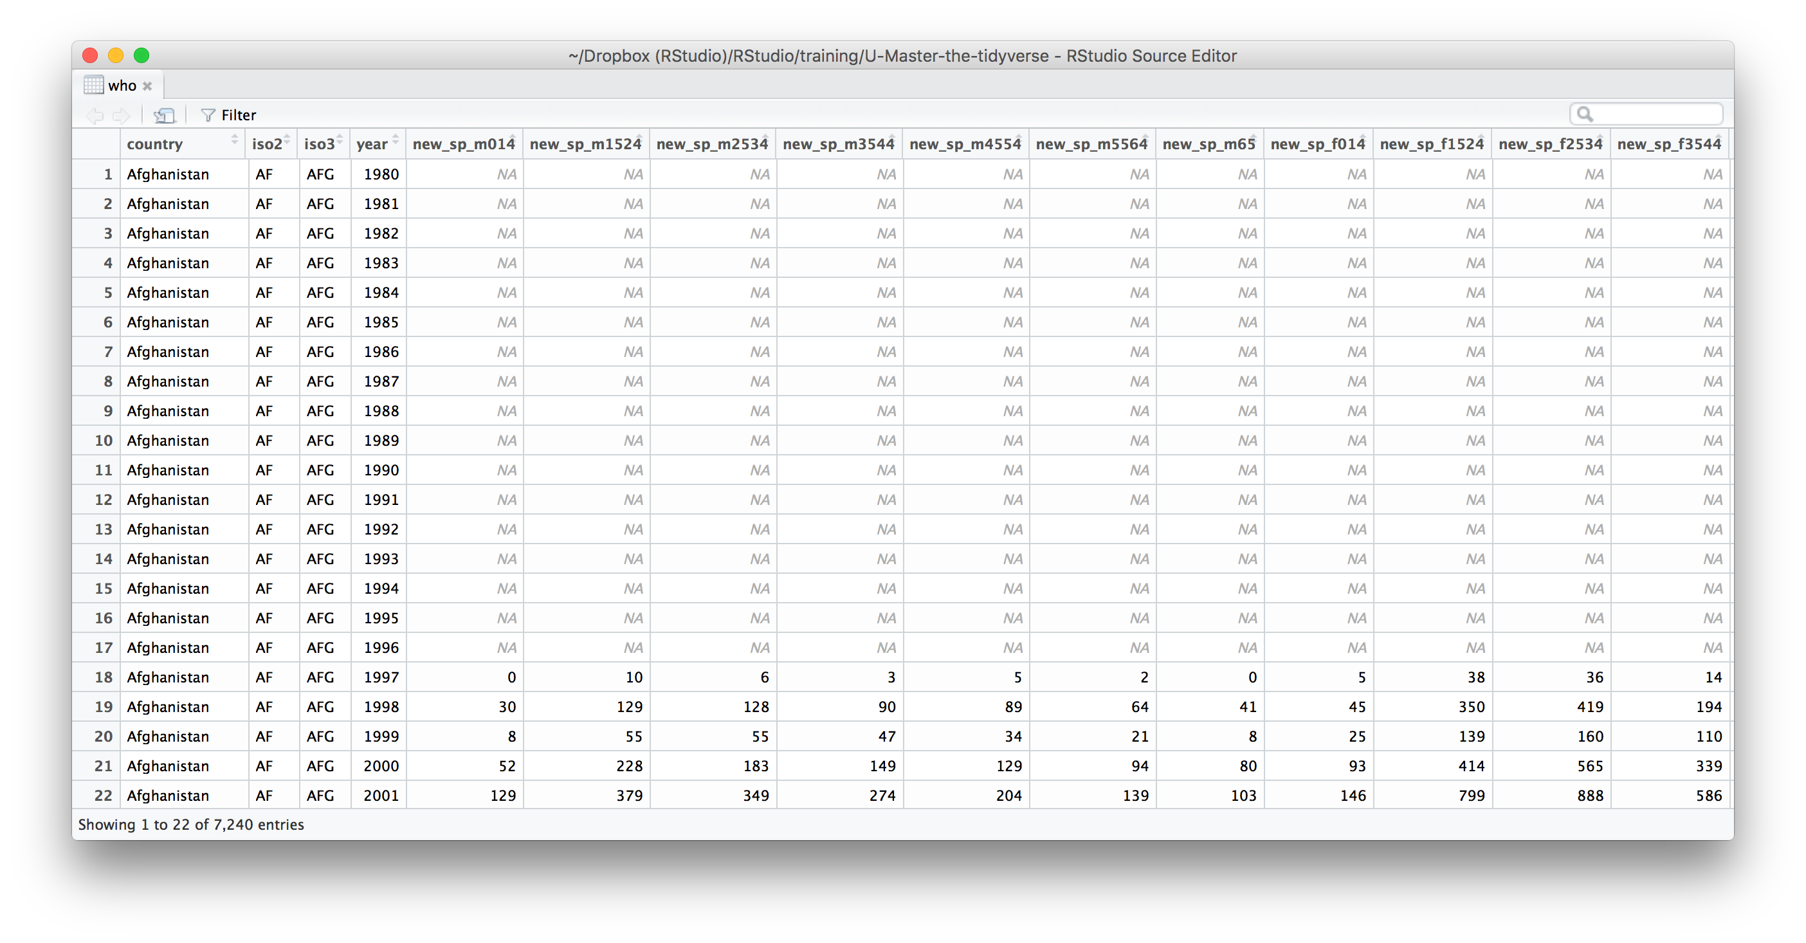
What variables does this data set contain?

Slide 74
The data uses the original codes given by the World Health Organization.
The column names for columns five through 60 are made by combining new_ to a code for method of diagnosis (rel = relapse, sn = negative pulmonary smear, sp = positive pulmonary smear, ep = extrapulmonary) to a code for gender (f = female, m = male) to a code for age group (014 = 0-14 yrs of age, 1524 = 15-24 years of age, 2534 = 25 to 34 years of age, 3544 = 35 to 44 years of age, 4554 = 45 to 54 years of age, 5564 = 55 to 64 years of age, 65 = 65 years of age or older).

Slide 75
WHO variables
country, iso2, iso3 - country identifiers
year - year
other columns names - encode type of TB case, sex, and age

Slide 76

WHO codes
Type of TB case
rel - relapse
ep - extra-pulmonary
sn- pulmonary, smear negative
sp -pulmonary, smear positive
Age group
014 - 0 to 14 years old
1524 - 15 to 24 years old
2534 - 25 to 34 years old
3544 - 35 to 44 years old
4554 - 45 to 54 years old
5564 - 55 to 64 years old
65 - 65 and older
Gender
m - male
f - female

Slide 78
Your Turn
pivot_longer the 5th through 60th columns of who into a pair of columns named codes and n.
Then select just the county, year, codes and n variables.

Slide 79
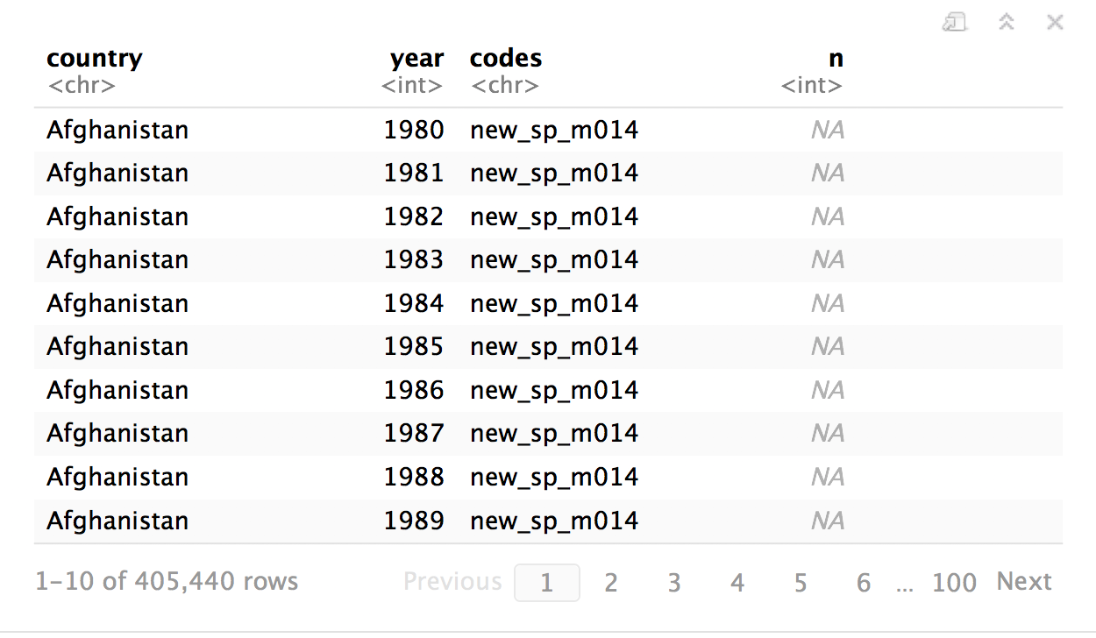
who %>%
pivot_longer(5:60, "codes", "n") %>%
select(-iso2, -iso3)

Slide 80
separate()

Slide 81
separate()
Splits a column by dividing values_from at a specific character.
who %>%
pivot_longer(5:60, "codes", "n") %>%
select(-iso2, -iso3) %>%
separate(codes, into = c("new", "type", "sexage"), sep = "_")
a column to split
names of new columns to make
separate on
(Defaults to any non_alpha-numeric character)

Slide 82
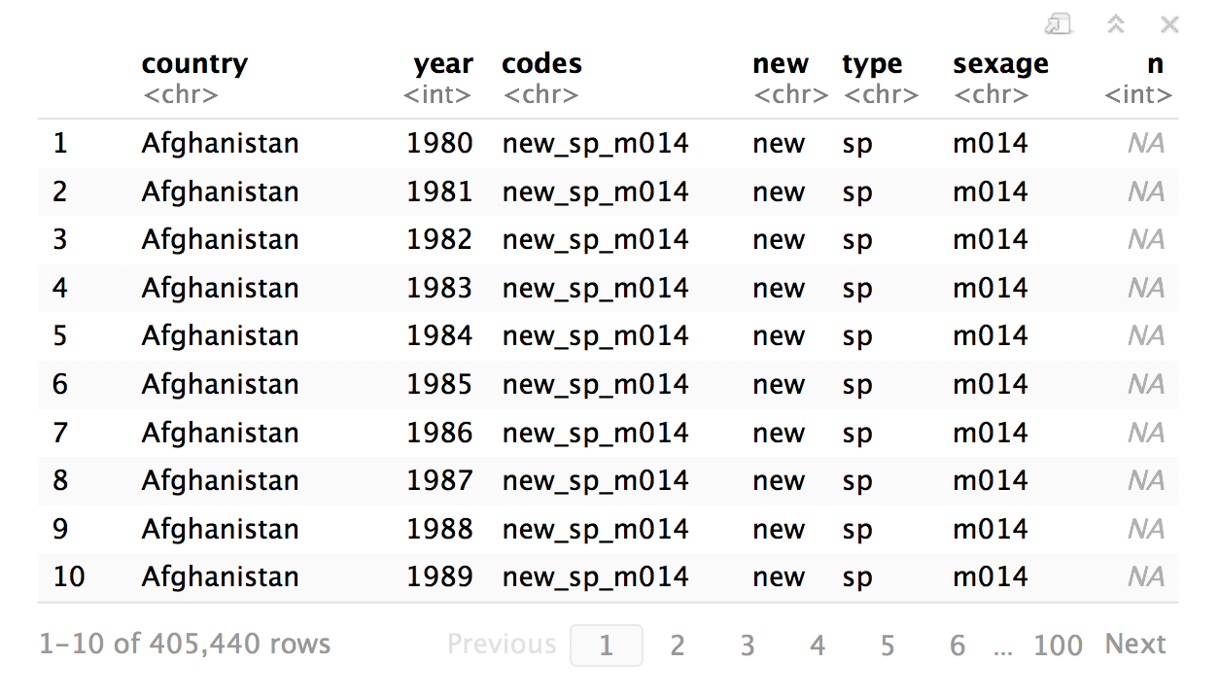
who %>%
pivot_longer(5:60, "codes", "n") %>%
select(-iso2, -iso3) %>%
separate(codes )

Slide 83
who %>%
pivot_longer(5:60, "codes", "n") %>%
select(-iso2, -iso3) %>%
separate(codes, into = c(“new”, “type”, “sexage”) )

Slide 84
who %>%
pivot_longer(5:60, "codes", "n") %>%
select(-iso2, -iso3) %>%
separate(codes, into = c(“new”, “type”, “sexage”),
sep = “_” )

Slide 85
who %>%
pivot_longer(5:60 = "codes", "n") %>%
select(-iso2, -iso3) %>%
separate(codes, into = c(“new”, “type”, “sexage”),
sep = “_” ) %>%s
select(-new)

Slide 86
Your Turn
Separate the sexage column into sex and age columns.

Slide 87
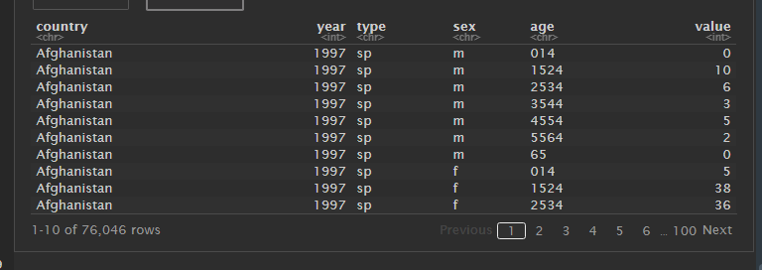
who %>%
pivot_longer(5:60, "codes", "n") %>%
select(-iso2, -iso3) %>%
separate(codes, c("new", "type", "sexage"), sep = "_") %>%
select(-new) %>%
separate(sexage, into = c("sex", "age"), sep = 1)

Slide 88
Reshaping Final Check

Slide 89
Your Turn
Can we calculate the ratio of boys to girls?
Reshape the layout of this data. Calculate the ratio of male to female) children by year.
babynames %>%
group_by(year, sex) %>%
summarize(n = sum(n))

Slide 90
Fancy new abilities in tidyr

Slide 91
Your Turn
Can we calculate the ratio of boys to girls?
Reshape the layout of this data. Calculate the ratio of male to females each year.
babynames %>%
group_by(year, sex) %>%
summarize(n = sum(n)) %>%
pivot_wider(names_from = sex, values_from = n) %>%
clean_names() %>%
mutate(ratio = f / m)

Slide 92

who %>%
select(-c(iso2, iso3)) %>%
pivot_longer(3:58,
names_to = c("new", "type", "sexage"),
names_sep = "_",
values_to = "value",
values_drop_na = TRUE
) %>%
select(-new) %>%
separate(sexage, into = c("sex", "age"), sep = 1)

